Slide 1


Hackathon 2 minor ai for good aircalm sdg 3
Haki Abdulovski (23177314)
Yassir Balah (26095270)

Slide 2
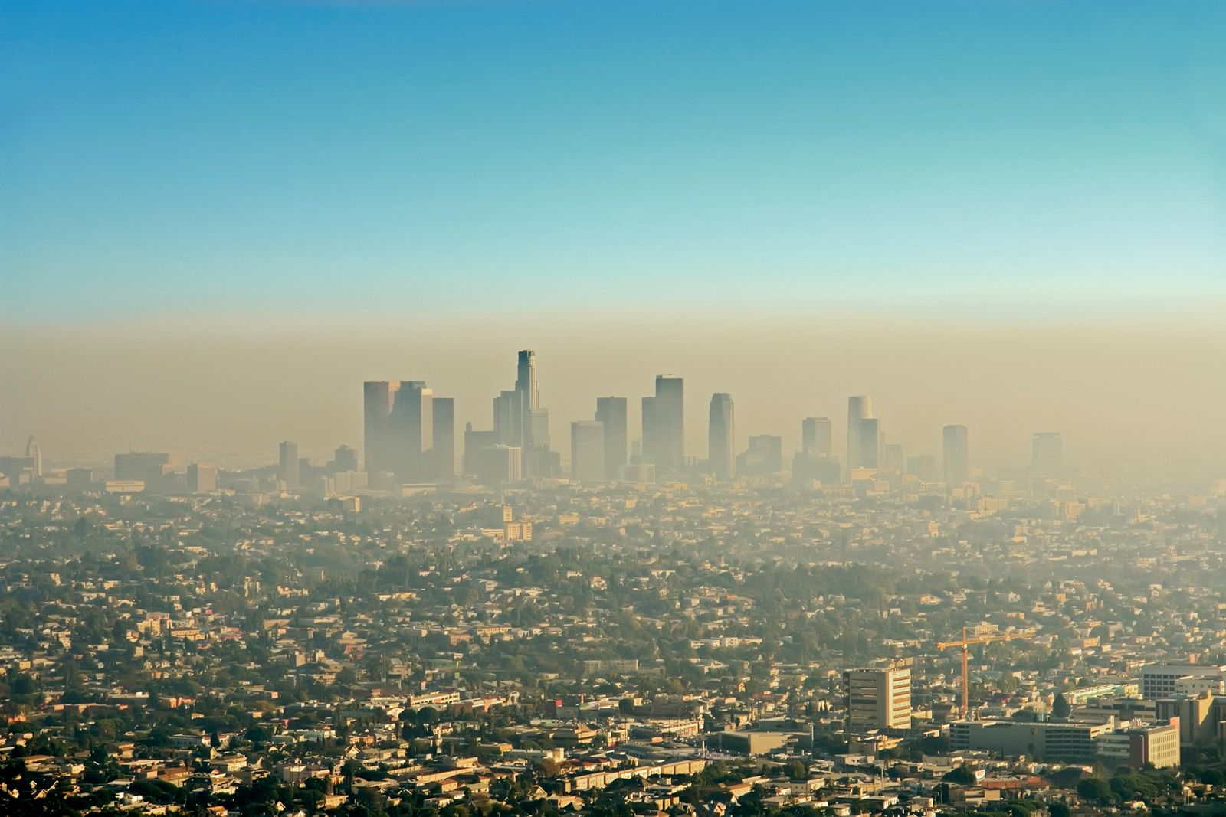
The problem
Poor air quality
Difficult to understand
https://www.britannica.com/science/photochemical-smog

Slide 3
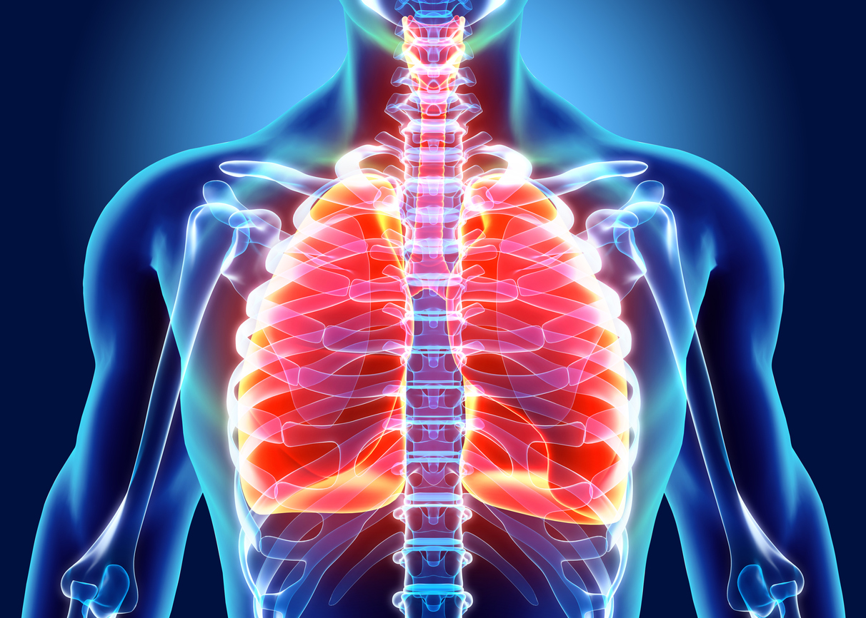
Target users
People with lung conditions
1.2 million people in the Netherlands with a certain lung condition
Source: https://www.longfonds.nl/longziekten/kerncijfers
People sensitive to poor air quality
Over half of the Dutch population is sensitive to bad air quality (Elderly, children, people with diabetes)
Source: https://www.rivm.nl/ggd-richtlijn-medische-milieukunde-luchtkwaliteit-en-gezondheid/gezondheidseffecten-luchtverontreiniging/luchtkwaliteit-hooggevoelige-groepen
https://www.thorax-schweiz.ch/en/the-lungs-pulmo/

Slide 4

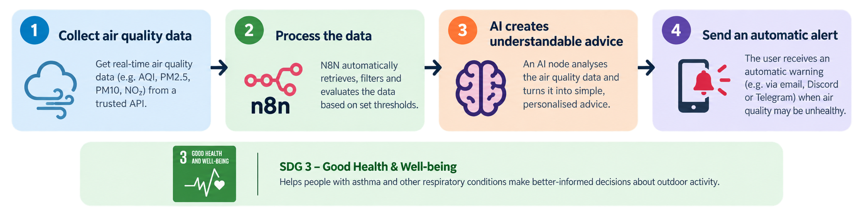
Our solution
Automated N8N workflow
Monitors air quality
Warning if condition may be unhealthy

Slide 5
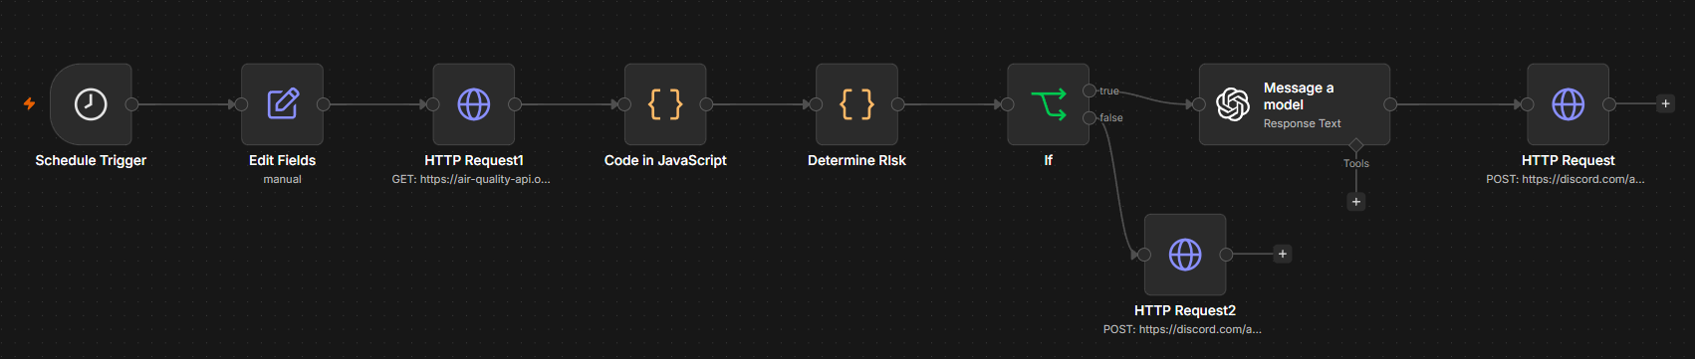
How the n8n workflow works

Slide 8
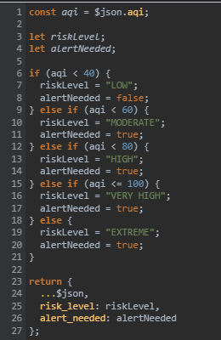
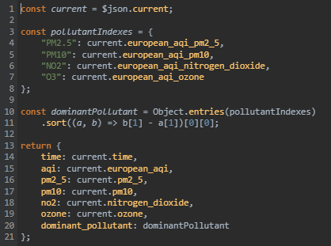
Code

Slide 9
Live-demo

Slide 10
Ethical reflection
Worse breathing problems or asthma symptons if warning comes late / fails
Tool should only be used as an extra warning tool, not as medical advise

Slide 11
The end
Questions?

